Slide 1
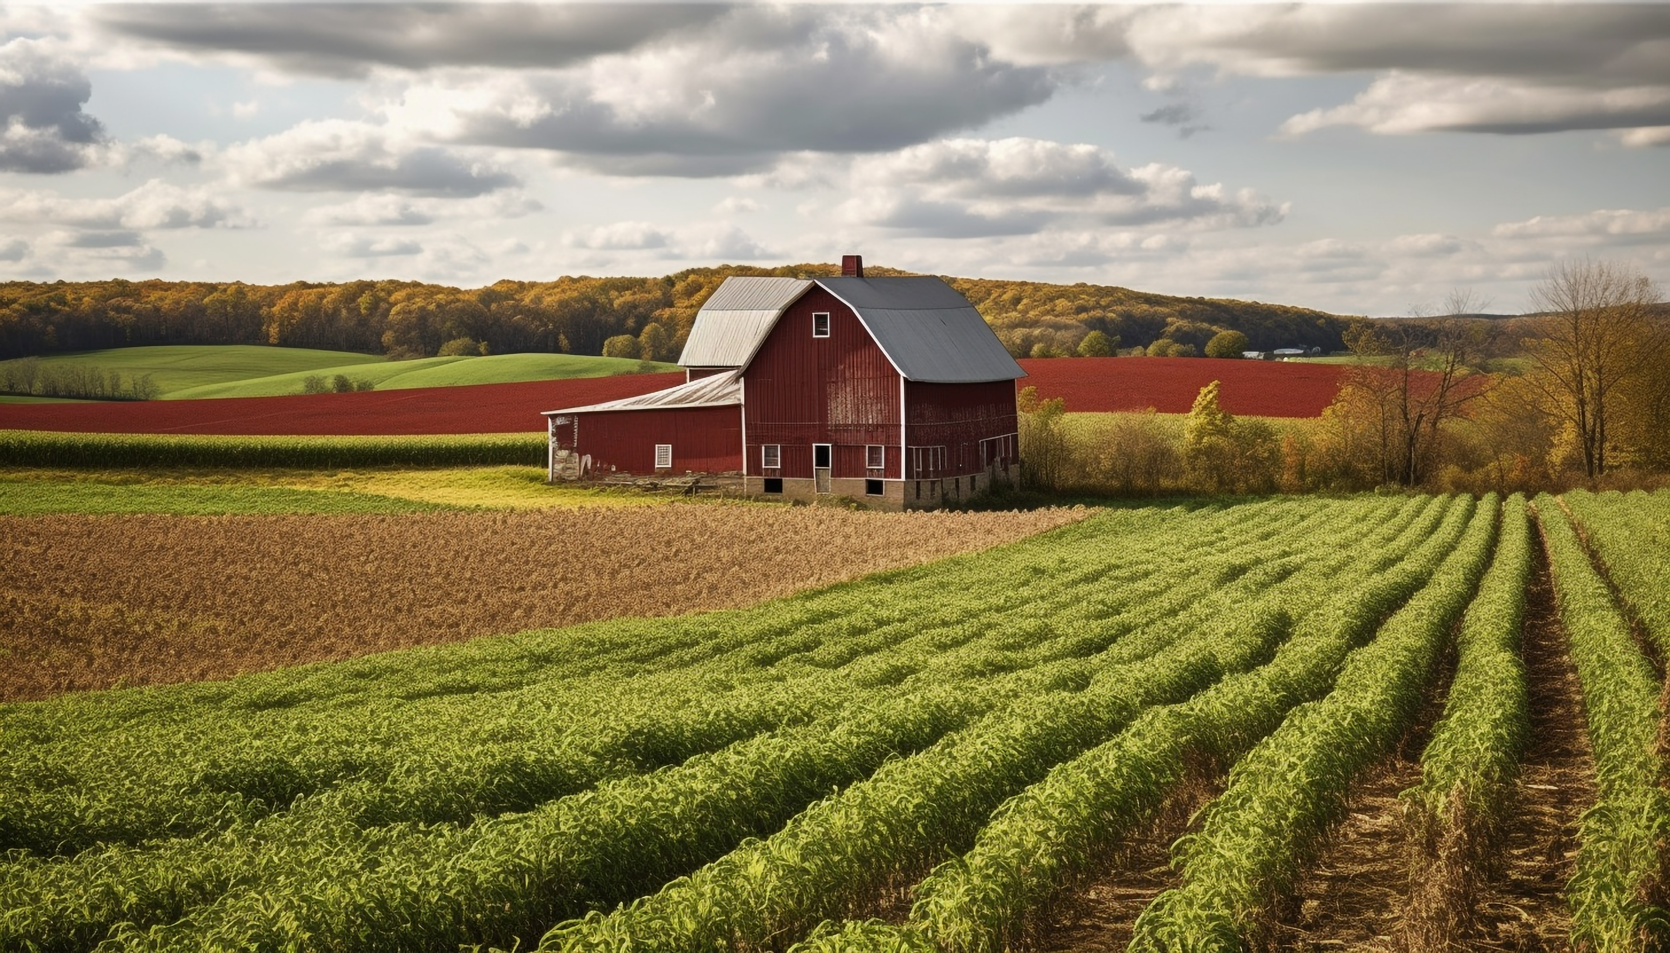
Digital Multimedia CA 1
Agriculture & Sales
Lorenzo Moares Nunez
23378441

Slide 2
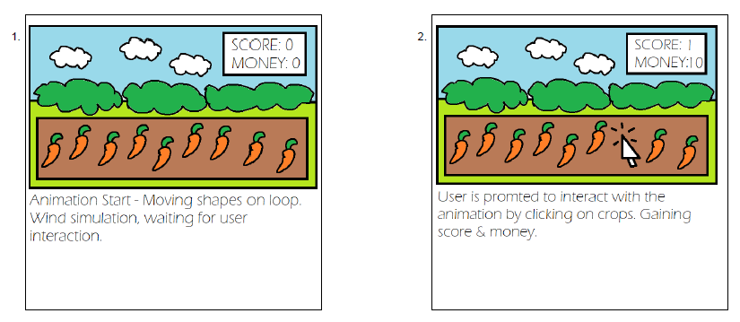
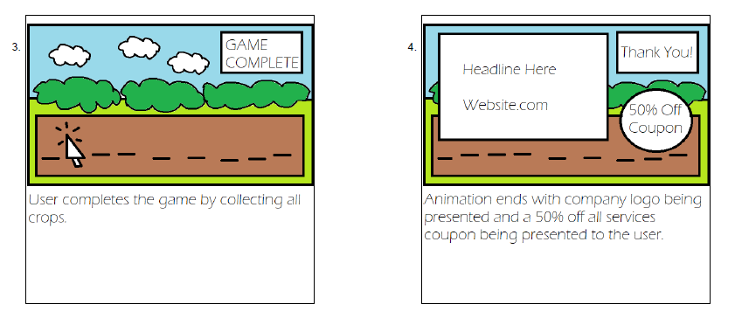
Storyboard

Slide 3
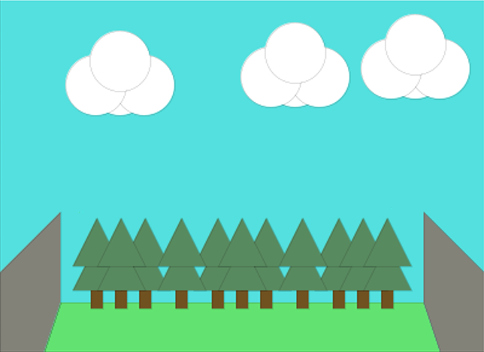
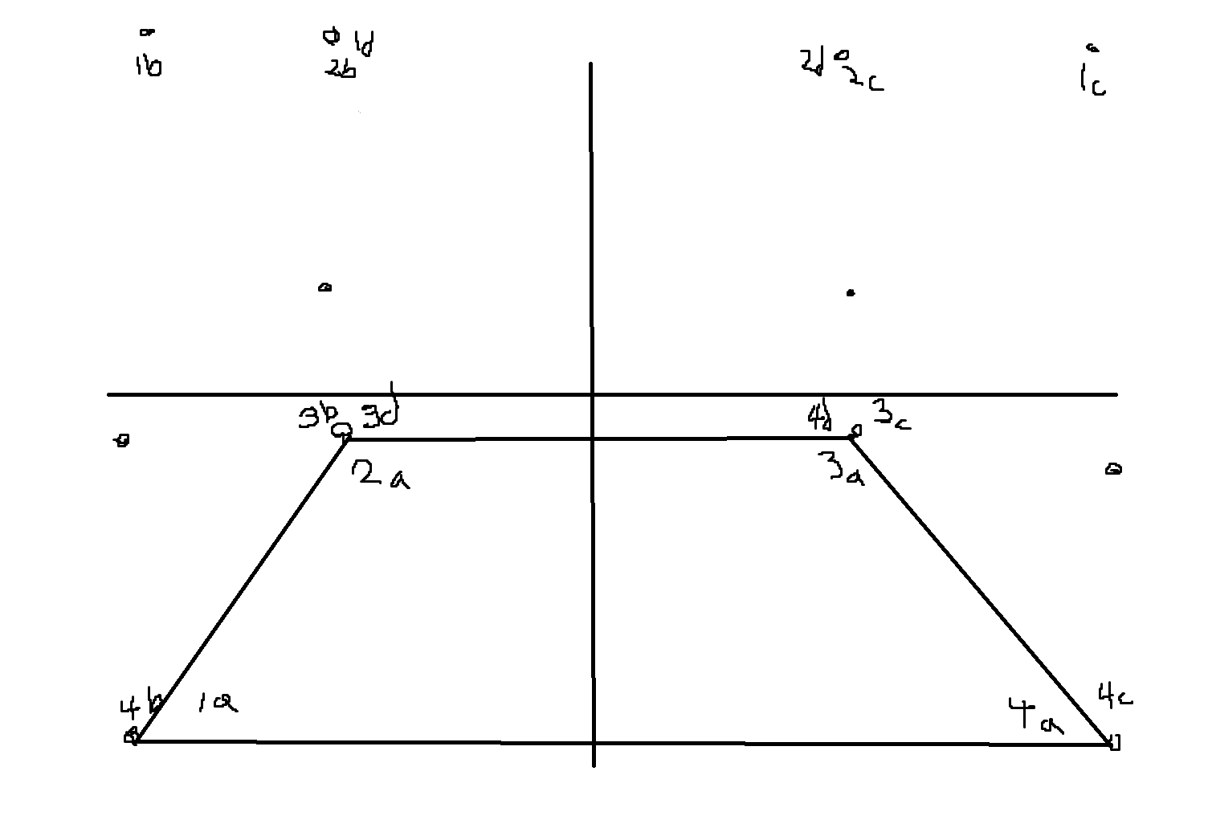
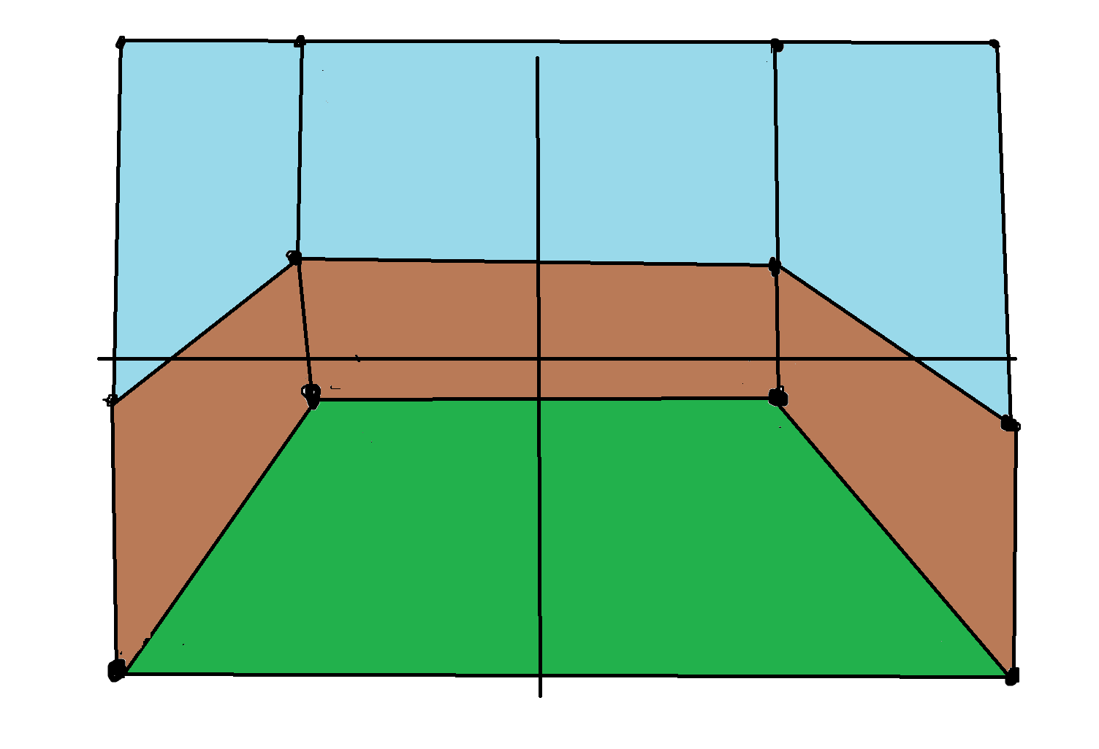
Processing Concept
Original Concept
Clear separation between Background & Foreground
Stage to house user interaction
Research on 2D/3D Perspective

Slide 4
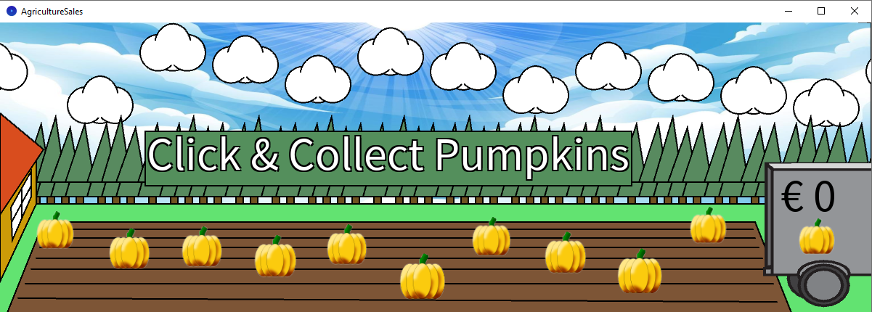
Finished Animated Advertisement
Wider Resolution
Interactive Banner
Use of moving shapes
Mix of game and looped animation
Imported Textured Background & Pumpkin images, Imported Vector Shapes
Pumpkin images scale based on perspective distance from screen

Slide 5
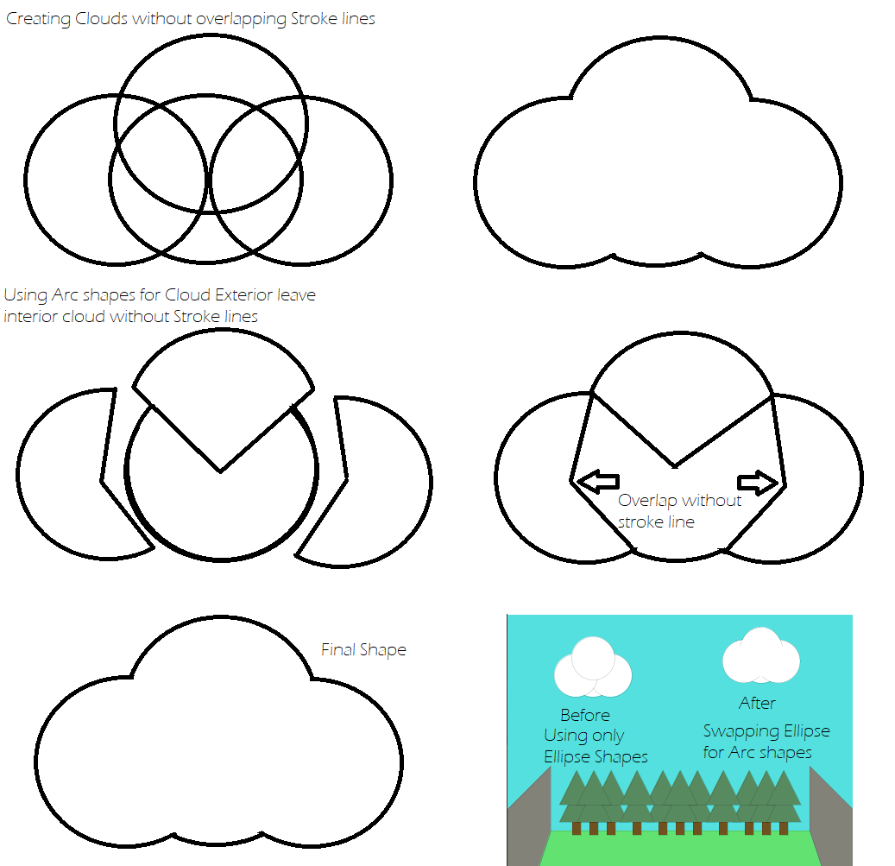
Cloud Geometry Planning & Solution
Creating Cloud Shape without overlapping Stroke Lines & using in-Processing Shape Methods
ellipse() Shapes versus arc() Shapes
Cloud positions reset on boundary exit
Requires each Cloud to be an object to track its unique X-Axis position

Slide 6
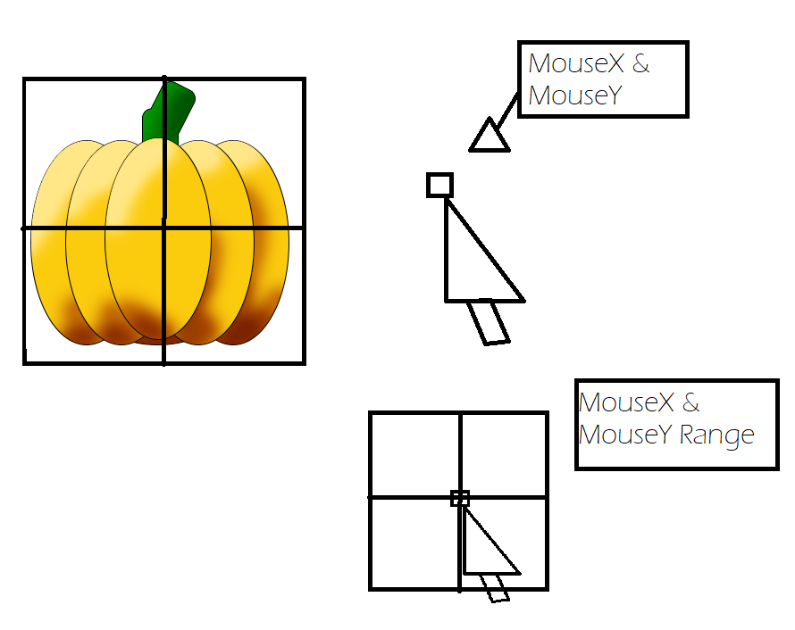
User Interaction Planning and Solution
Complication with determining if player clicks on Pumpkin shape
Utilizing a range threshold of X-Axis & Y-Axis positions based on Mouse X & Y position
Intersecting Mouse and Shape with both X and Y-Axis triggers interaction instructions
Pumpkin Y-Axis set to off-screen position. Requiring each Pumpkin to be a unique object.

Slide 7
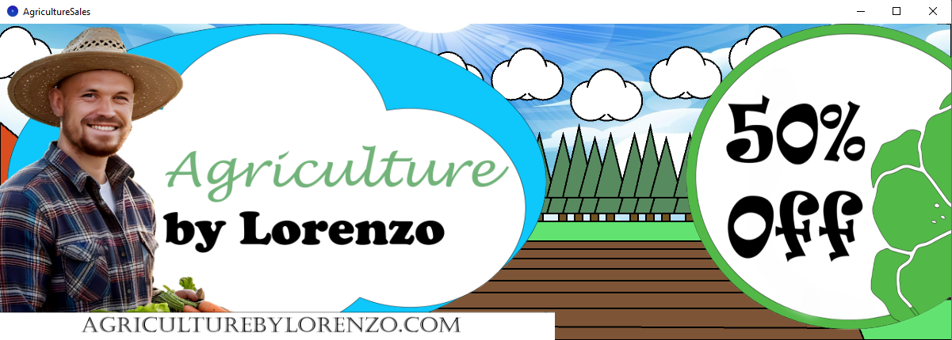
Animation Ending
Game Completion
Assets scroll into frame
Photoshop PNG assets
Animation continues

Slide 8

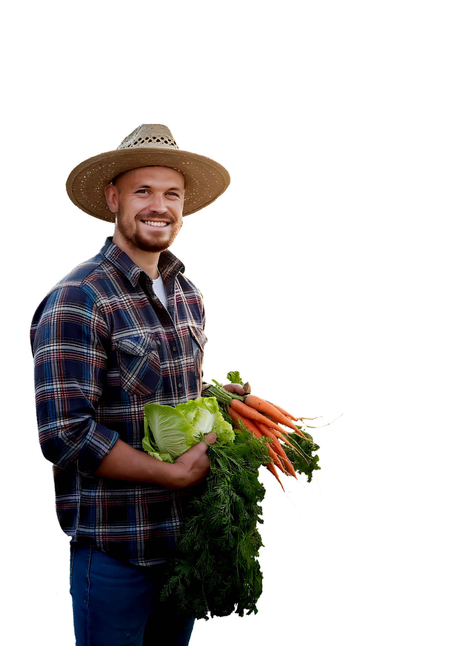
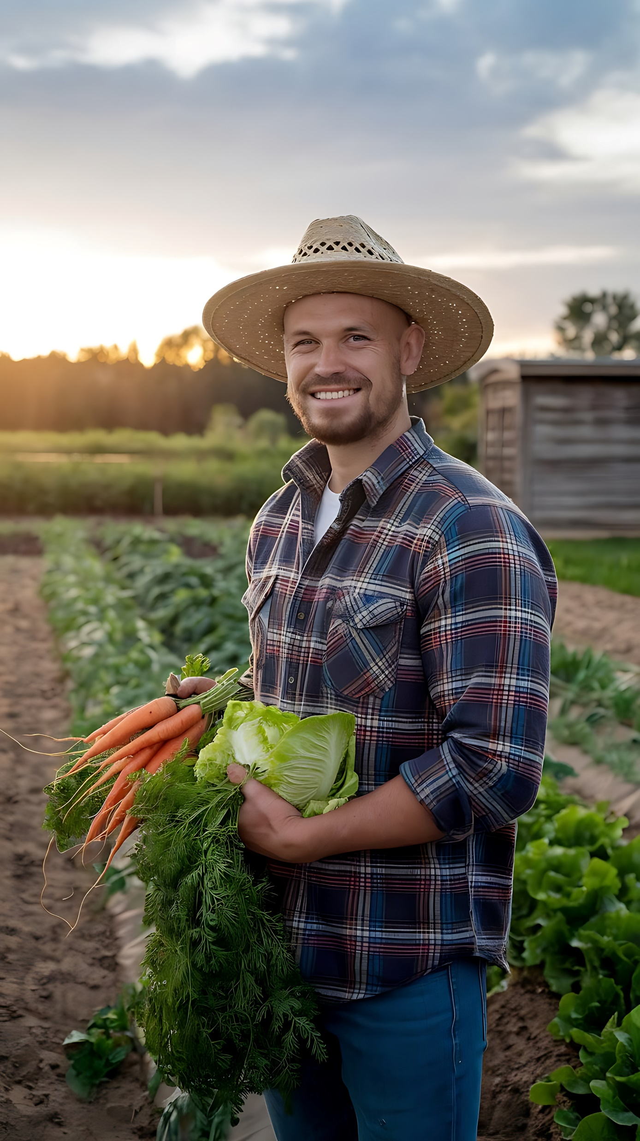

Animation Logo
Logo Shapes – Photoshop
Actor – image taken from Vecteezy.com
Colour Correction, highlighting face, removing background

